Slide 1
Session Tracking
Presented by : Asfiya Khan ( Sr. Technical Trainer)

Slide 2
Agenda
What is Session?
How to maintain sessions?
Different way of session tracking.

Slide 3
Session
Session is simply the limited interval of time in which two systems communicate with each other.
As HTTP is a stateless protocol, server do not remember the client over multiple request.
In situations where a series of request and response takes place between same client and a server (for example online shopping system ) so to maintain the conversational state , session tracking is needed.

Slide 4
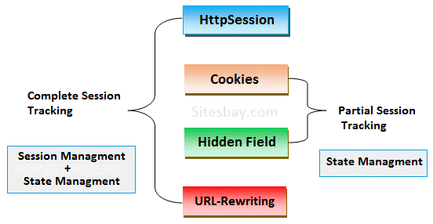
Session Tracking Method
Hidden Form Fields
URL Rewriting
Cookies
Http Session

Slide 5
Hidden Form Fields
Hidden Form Fields can be used for storing Session Information
This information can be retrieved later on through HttpServletRequest.
This cannot be used for session tracking when the conversation included static resources like html pages.
Syntax
Limitations:
- Can be used only on Dynamically generated pages
- Security loopholes
<input type="hidden" name="uname" value="porter">
Notes:
Hidden Form Field Advantage
Basic knowledge of html is enough to work with this technique.
It will always work whether cookie is disabled or not.
Hidden boxes resides in web pages of browser window so they do not provide burden to the server.
This technique can be used along with all kind of web server or application server.
Hidden Form Field Dis-Advantage
More complex than URL Rewriting.
It is maintained at server side.
Extra form submission is required on each pages.
Hidden form field can not store java object as values. They only store text value
It Also increase network traffic because hidden boxes data travels over the network along with request and response.
Hidden boxes does not provides data security because their data can be view through view source option.

Slide 6
URL Rewriting
Session parameters are appended to the URL.
It is a less elegant solution as :
- Session cannot be maintained by requesting well-known urls
- Does not allow the use of static pages
- URLs may get quite lengthy
- Must be ensured that every URL referencing your site is
appended with session info
- It brings up some privacy issues
- User may leave the session & come back with a bookmark.
In such cases, Session info is lost.
Notes:
Advantage of URL Rewriting
It will always work whether cookie is disabled or not (browser independent).
Extra form submission is not required on each pages
Dis-advantage of URL Rewriting
Generate more network traffic.
It will work only with links.
It can send Only textual information.
Less secure because query string in session id displace on address bar.

Slide 7
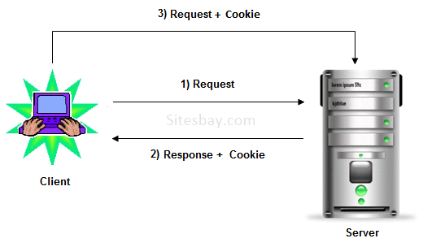
How Cookie works?

Slide 8
Cookies
This is the most common way of Session Tracking
Cookies (Name-Value pairs) are sent to client by server.
Client sends them back if it wants to continue with session
Limitations:
-Cookie can not grow more than 4k in size
-Cookie may pose some privacy concern for user

Slide 9
Methods of Cookie class
Methods | Description
public void setMaxAge(int expiry) | It is used for Sets the maximum age of the cookie in seconds.
public String getName() | It is used for Returns the name of the cookie. The name cannot be changed after creation.
public String getValue() | It is used for Returns the value of the cookie.
public void setName(String name) | It is used for changes the name of the cookie.
public void setValue(String value) | It is used for changes the value of the cookie.
public void addCookie(Cookie ck) | It is method of HttpServletResponse interface which is used to add cookie in response object.
public Cookie[] getCookies() | It is method of HttpServletRequest interface which is used to return all the cookies from the browser.

Slide 10
HTTP Session Tracking
This is a reliable way of Session Tracking.
Obtain a session object.
Add name-value pairs to Session through setAttribute().
Retrieve values using getAttribute().

Slide 11
HTTP Session API
Method | Description
public HttpSession getSession(): | It returns the current session associated with this request, or if the request does not have a session, creates one.
public HttpSession getSession(boolean create) | It returns the current HttpSession associated with this request or, if there is no current session and create is true, returns a new session.
public String getId() | It returns a string containing the unique identifier value.
public long getCreationTime() | It returns the time when this session was created, measured in milliseconds since midnight January 1, 1970 GMT.
public long getLastAccessedTime() | It returns the last time the client sent a request associated with this session, as the number of milliseconds since midnight January 1, 1970 GMT.
public void invalidate() | Invalidates this session then unbinds any objects bound to it.
Notes:
Dis-Advantage of HttpSession
Http session objects allocate memory on the server so this increase burden on the server.
If cookies are restricted coming to browser window this technique fails to perform session tracking.

Slide 12


Copyright © 2019 Cybage Software Pvt. Ltd. All Rights Reserved. Cybage Confidential.
www.cybage.com

Slide 13


Thank You!
11/18/2019
www.cybage.com
Copyright © 2019 Cybage Software Pvt. Ltd. All Rights Reserved. Cybage Confidential.

